Slide 1


Ad-hoc Query Dependencies
Tudor Pop
Principal Software Engineer,
Blackbaud
Notes:
Hello everybody, my name is Tudor Pop and I’m a principal software engineer at Blackbaud. Today I will talk about the implementation of an idea portal entry around ad-hoc query dependencies.

Slide 2
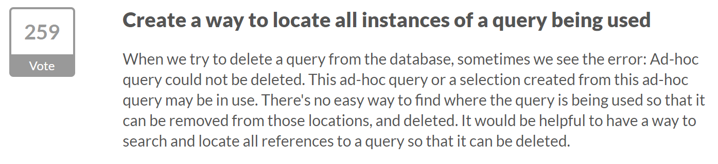
What’s the big idea?
Notes:
So, what problem are we trying to solve? Basically when trying to delete a query from the system, if that query or a selection created from it are in use somewhere in the system, the user will get an error message that doesn’t contain too much information. So how do we let the users know what prevents this query from being deleted?

Slide 3
Approach
Map out the places in the system where ad-hoc queries are in use
Create a dependency chain
Allow the user to view dependencies on demand
Present detailed query dependency information
Enable user to easily take action
Notes:
Starting from this question we decided to approach the problem by first mapping out all of the places in the system where ad-hoc queries and their selections could be used. With that information we created a query dependency chain in order to help the user visualize the dependencies on demand. Along with that we’re offering detailed query dependency information and we’re giving the user a path to address the dependencies that prevent the query deletion

Slide 4
Highlights
All dependencies are captured (including on custom artefacts)
Dependencies that prevent the delete highlighted
Common dependencies (ad-hoc queries, smart queries, exports, smart fields)
Easy navigation to common dependencies
Record type information on all dependencies
Administrator level access
Notes:
With that being said here are some of the implementation highlights. We are capturing all the dependencies a query might have, including dependencies on custom artefacts. Since not all dependencies prevent the deletion of a query we are highlighting the ones that do and providing easy navigation to the most common dependencies such as other ad-hoc queries, smart queries, exports or smart fields. Additionally we are providing record type information on all dependencies. Lastly, this feature is only available to administrator users due to elevated rights needed to run the underlying processes. So let’s see how this looks like in CRM.

Slide 5
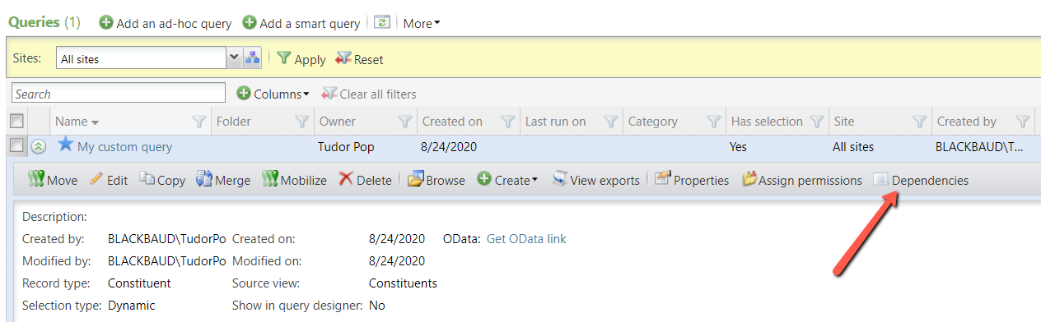
Implementation
Notes:
When a user navigates to the information library query list and clicks on any ad-hoc query, a new button, called dependencies, is now available on the detailed view panel. Clicking that button will bring up a new page that is used to determine and display all the dependencies that query might have.

Slide 6
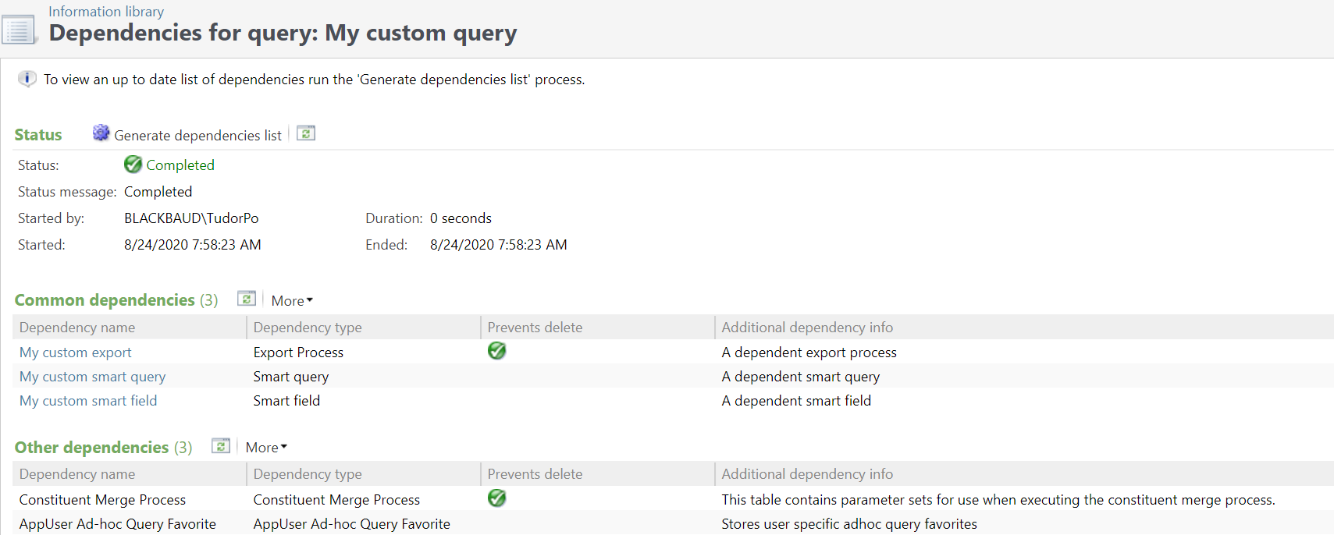
Implementation
Notes:
As you can see the page lets the user run a business process that will calculate and generate the list of the dependencies for the query in question. The results are displayed under two separate sections, one containing common dependencies and the second one all other dependencies. As mentioned before the user is made aware of what dependencies prevent the delete operation and they can also navigate to some of the dependencies in question via a link button. Other information like dependency record type and additional information are also provided. In this example our ad hoc query cannot be deleted because of an export process and a constituent merge process that use the query or its selection. Ok, we’ve seen how this works, let’s talk about how we implemented all of this.

Slide 7
Under the hood
Standard business process implementation
One single processing SQL routine
Single table for storing dependencies
System tables querying for SQL object dependency mapping
Dynamic SQL for modeling the raw data
Separate data lists for most common and other dependencies
Notes:
Under the hood we are using a standard business process implementation that will execute a main sql stored procedure. This stored procedure will generate the dependencies which we then store in a database table. We use dynamic sql and we query sql system objects to build the raw dependency data, which we then model and massage in order to display it via two data lists, for common and other dependencies.

Slide 8
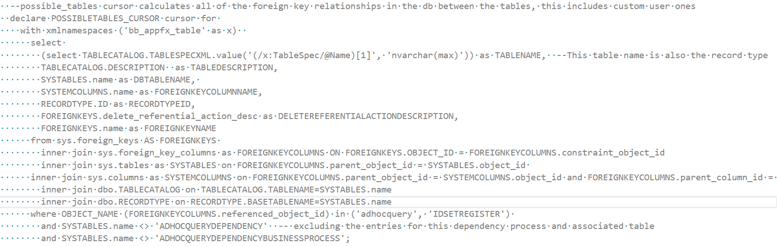
Under the hood – raw data gathering
Notes:
Here’s a look at some of the SQL code that is used to query the system tables. We are looking for both direct and indirect connections between our ad-hoc query and other objects in the system.

Slide 9
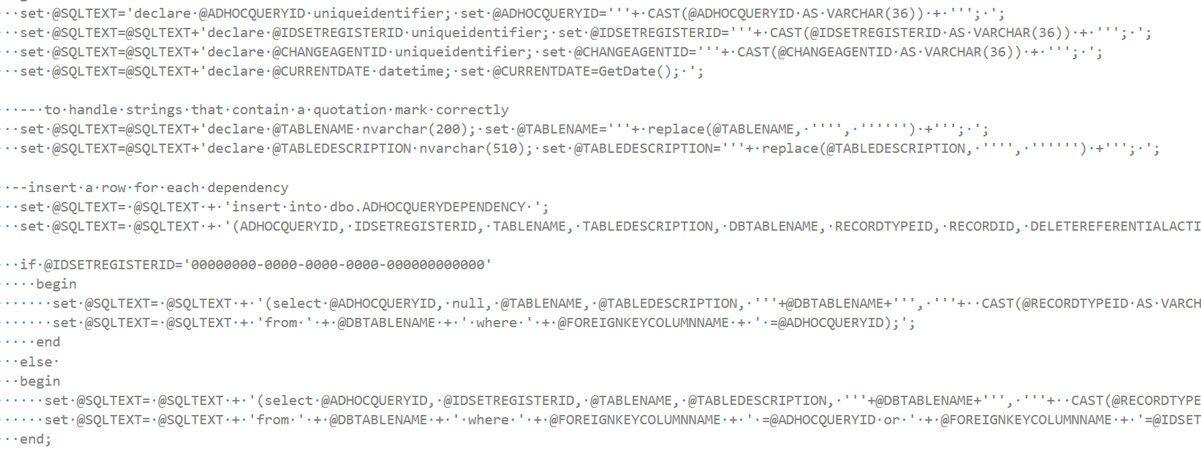
Under the hood – raw data massaging
Notes:
Once we have that data we go ahead and insert into the dependencies table via some dynamic sql magic.

Slide 10
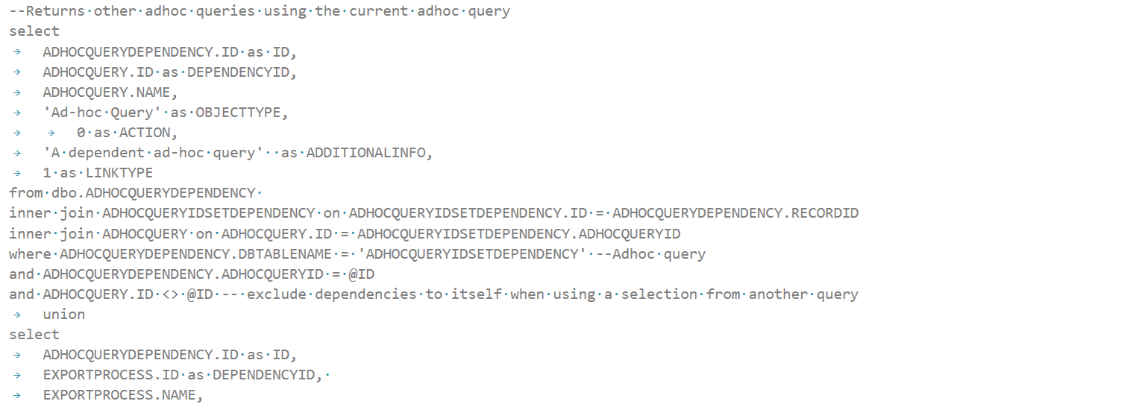
Under the hood – common dependencies
Notes:
Then, we use the data lists I previously mentioned to properly display the results we stored in the dependencies table. In this code snippet we’re showing dependencies our query might have on other ad-hoc queries, while obviously excluding dependencies to itself.
Some final thoughts about this approach: given this is a business process centric implementation, the user can start the process and leave the dependency page and return upon completion. And like I mentioned on a previous slide this feature is only available to administrator users. Furthermore it only covers ad-hoc query. Smart query is not implemented at this time.
In a nutshell, these are some of the highlights of our ad-hoc query dependencies implementation.

Slide 11
More Ideas Portal Implementations
Tudor Pop
Principal Software Engineer,
Blackbaud
Notes:
Moving on I will quickly mention some of the other ideas portal suggestions we implemented and released.

Slide 12
Released CRM ideas
Enable site security on user-defined data lists
Implement Enqueue for the credit card business process
Generate a Constituent Update Batch from a selection
Include start date when running the Add Constituent Attribute Global change
Reduce recognition credits option when globally writing off a pledge
Ability to clear partially paid matching gift claims
Global delete constituent attribute based on attribute value
Notes:
We added site security to data lists generated by users from ad-hoc queries. We implemented enqueue for the credit card processing business process. Constituent update batches can now be generated from a selection. Start date is included on the add constituent attribute global change. We also implemented the suggestions around reducing recognition credits when globally writing off a pledge and the ability to clear partially paid matching gift claims. Lastly CRM users can now globally delete constituent attributes based on the actual attribute value.

Slide 13

Notes:
And this concludes my presentation. Thank you very much for your attention.

